Slide 1
Welcome

Slide 2
Lesson
Teacher
Md. Shajedur Rahman
Lecturer of English
Ali M.P.G Alim Madrasah
Akkelpur,Joypurhat.
Email: shajedurrahman06@gmail.com
Mobile: 01712 53 14 95
Class: xi
Subject: English-1
Unit Five: Adolescence
Lesson: 1
Time: 50:00 mins.
Date: 23/10/2016

Slide 3
Lets see the pictures (01:00 mins.)

Slide 4
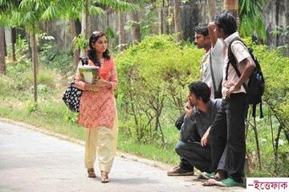

Slide 5
Lets watch the video

Slide 6
Today’s Topic:
The Storm and Stress of adolescence.

Slide 7
Learning Outcomes
By the end of the lesson, the learners will be able to-
Tell about the adults.
Explain the teenage.
Describe the problems of adolescence.

Slide 8
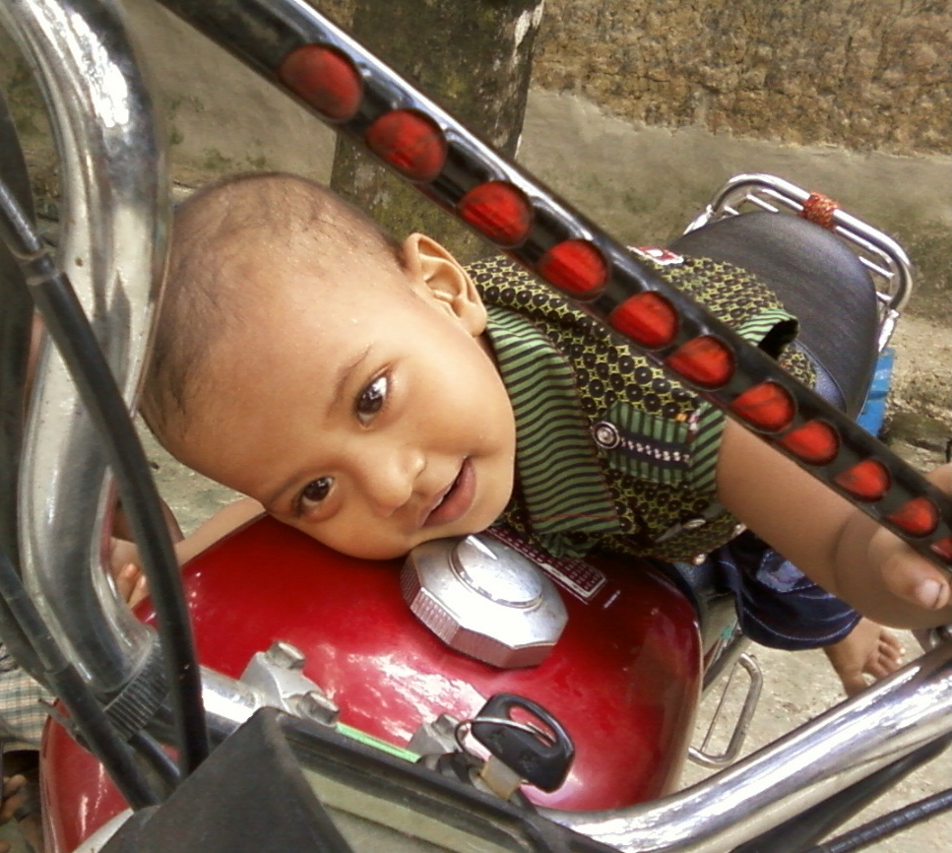
Children must pass through several stages in their lives to become adults.
Birth to age 2 children

Slide 9
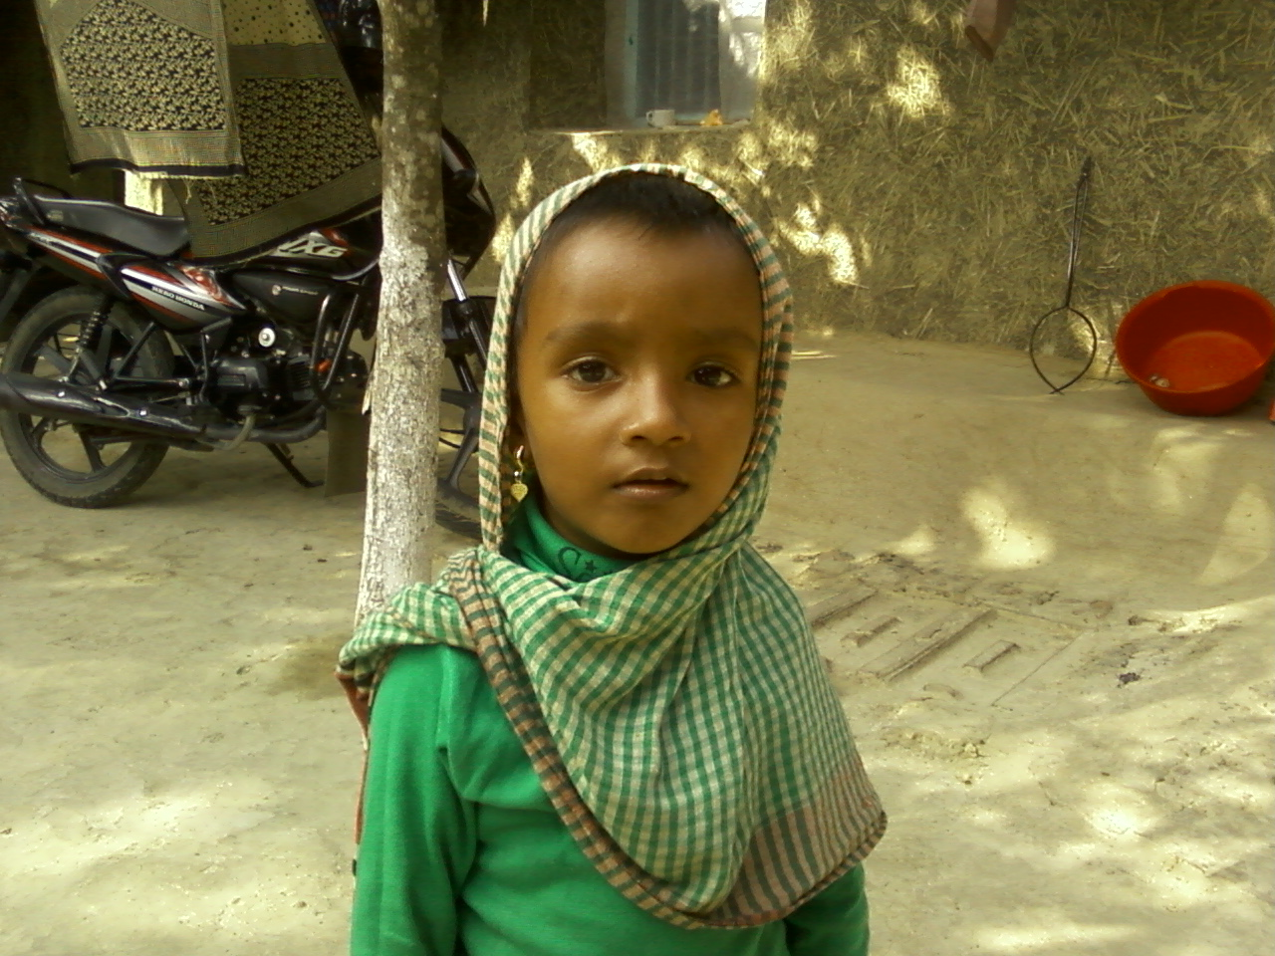
Children must pass through several stages in their lives to become adults.

Slide 10
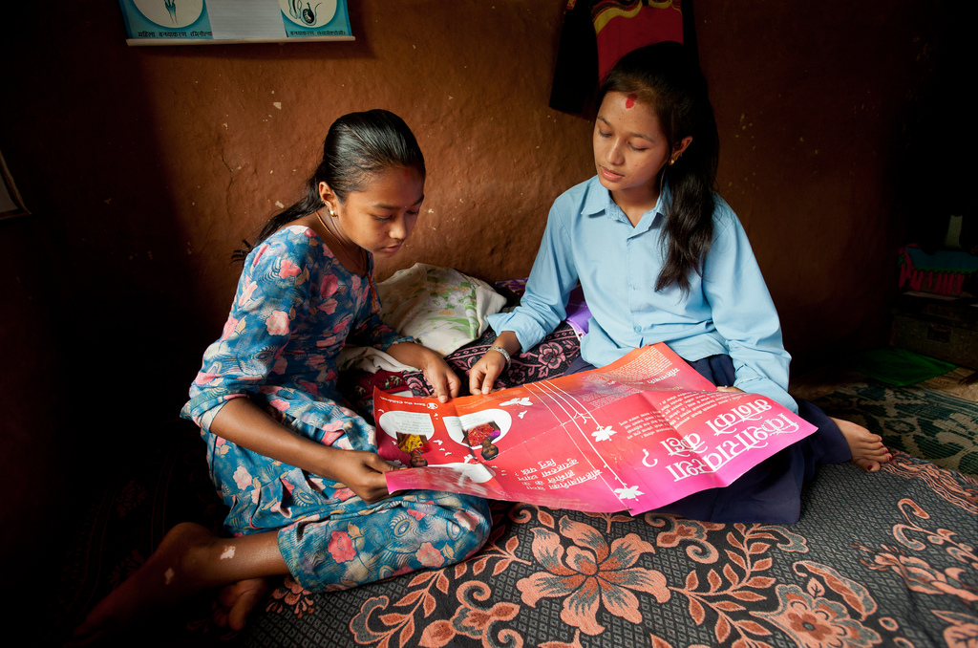
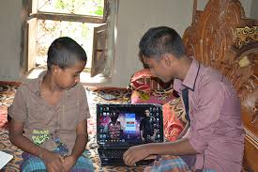
Children must pass through several stages in their lives
to become adults.
09 to 12 years

Slide 11
13 to 18 years

Slide 12
Children must pass through several stages in their lives to become adults.
Adults

Slide 13
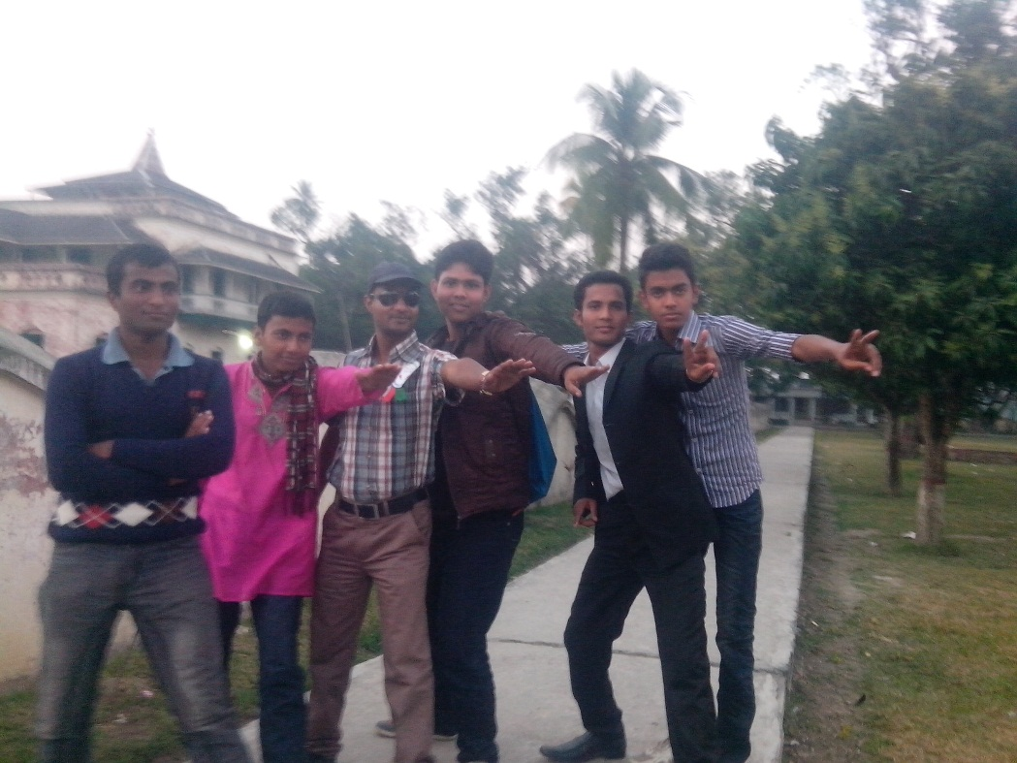
Adults

Slide 14
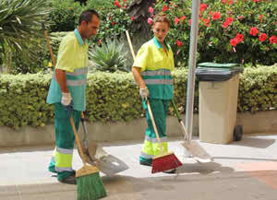
Pair work (5:00 mins.)
What age group do you belong to? ( 16-17, 18-21, 22-23)
Do you think you are old enough to face the world?
Do you ever feel that people do not pay you much attention because of your age? Why?

Slide 15
For most people, there are four or five stages of growth where they learn certain things:
Persons 18 and over are considered adults in our society.
Of course, there are some who will try to act older than their age.
But, for most part, most individuals have to go through these stages irrespective of their economic or social status.

Slide 16
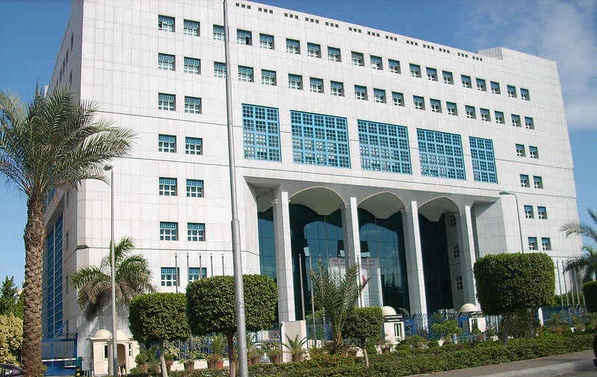
World Health Organization says
WHO identifies adolescence as the period in human growth and development that occurs after childhood and before adulthood.

Slide 17
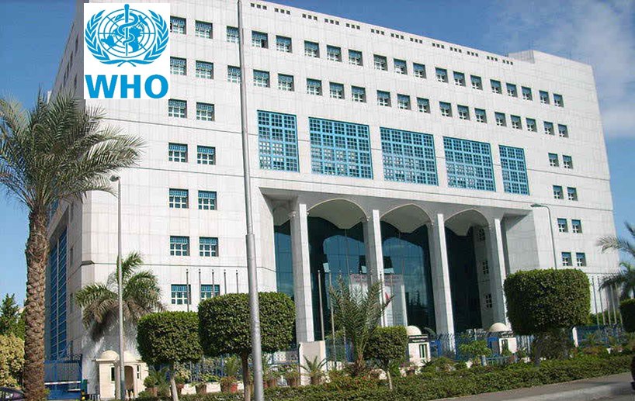
World Health Organization says
This period has seen many changes over the past century- puberty for example, comes earlier than before, people marry late, and their sexual attitudes and behaviours are different from their grandparents, or even parents.

Slide 18
World Health Organization says
Among the factors responsible for the change are education, urbanization and spread of global communication.

Slide 19
Individual work (10:00 mins.)
Read paragraph 3 from the text, page no. 48 and answer the following question.
What is the different between adulthood and adolescence? Write in your own language. About 100 words.

Slide 20
Adolescents are different both from young children and adults.
Actually, they are not capable of understanding complex concepts.
Such as- good health, decision making, and related to sexual behavior.

Slide 21
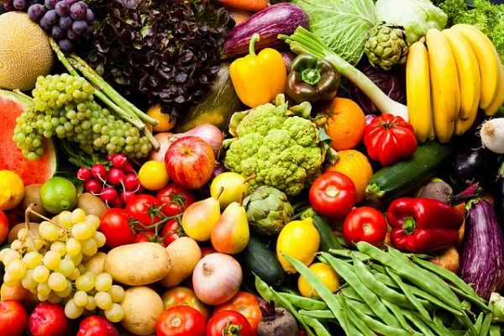
Such as- good health, decision making, and related
to sexual behavior.
This inability may make them particularly vulnerable
to sexual exploitation.
Laws, customs, and practices may also affect adolescents differently than adults.

Slide 22
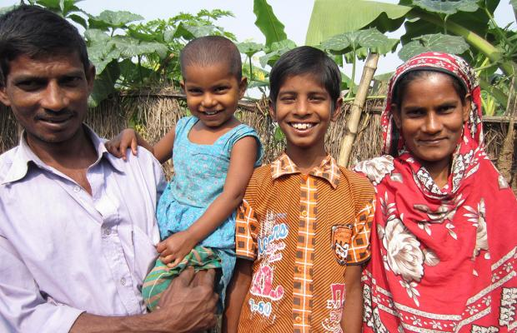
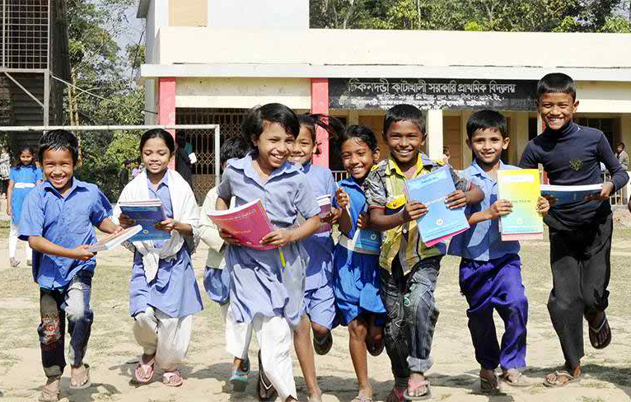
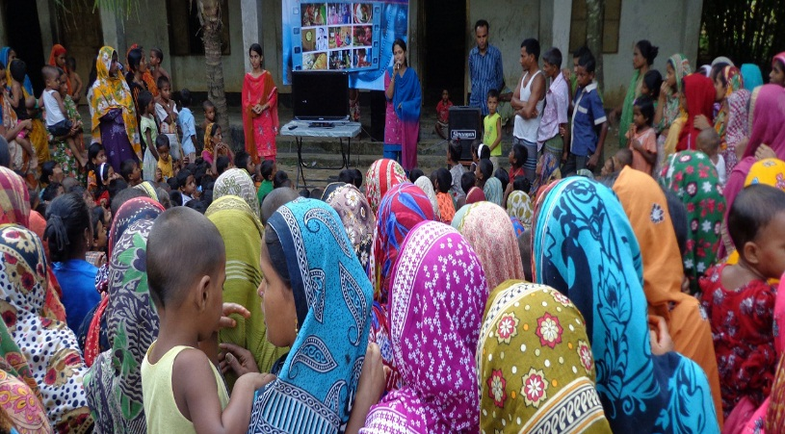
World Health Organization says
Adolescents depends on their families, communities, schools, and their workplaces, to learn a wide range of skills that can help them to cope with the pressures they face and make a successful transition from childhood to adulthood.
Parents, members of the community, service providers, and social institutions have the responsibility to both promote adolescent development and adjustment and to intervene effectively when problems arise.

Slide 23
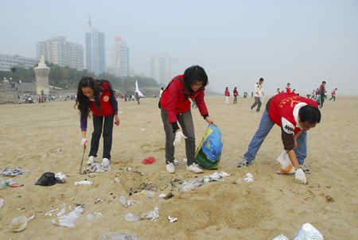
Group work (10:00 mins.)
Answer the following questions-
What changes are you experienced by the adolescent youths?
What are some of the potential health risks faced by the adolescents?
How are the adolescents different from the children and adults?
What role can the society and community play in promoting the adolescents?

Slide 24
Single work
What do the following words/terms mean?
Infancy
Puberty
transition

Slide 25
Homework
Do you think you are getting enough support from your family, school and community? What do you expect them to do for your proper development?

